Slide 1


THE EXPORT PROCESS
Shandilayne Davis
Jamaica Customs Agency

Slide 2
Where to Begin?
The commercial export process begins with applying to JAMPRO to become a registered exporter

Slide 3
Things to Consider
All items leaving the Island are subject to Border Controls as stipulated by the Customs Act and enforced by the JCA
No taxes are levied on exports
Intrusive examinations of export cargo are conducted based on risk assessment
All export cargo is subject to non intrusive examinations i.e. scanning at all Ports

Slide 4
Laws Governing Export
Part V sections 133 -159 of the Customs Act governs the outward movement of cargo, baggage, ship stores, vessels and aircrafts.
    Sec. 143 – restrictions on the exportation of certain goods
    Sec. 145 – general provisions governing exports
    Sec. 156 – notification re short-loading of cargo

Slide 5

Types of Exports
Domestic Exports
Temporary Importations
Exportation for subsequent re-importation

Slide 6

Domestic Exportation

Slide 7
Exporting by Sea
Complete booking with shipping company
Complete Export Entry (C87)
Complete Commercial Invoice (C23)
Contact JCA’s Contraband Enforcement Unit 24hrs before loading the goods into the container
Complete Dock Receipt issued by shipping agent
Present dock receipt to wharf office (pay security fee)
Pay customs processing fee ($3005)
Submit completed entry form, dock receipt and other applicable documents to the export officer for processing.
Deliver cargo to wharf

Slide 8
Exporting by Air
Complete customs entry, invoice, certificate / permit (where applicable), tally sheet and dispatch form.
Contact JCA’s Contraband Enforcement Unit 24hrs before loading the goods into the container
Pay customs processing fee ($3005)
Present documents and goods to export officer for checking, signing and numbering.
Deliver cargo to the airline's warehouse
Present tally sheet along with dispatch form to the airline representative who will facilitate the entry of goods into the warehouse.
Some airline may require prior booking.

Slide 9
Exportation may be approved for goods which were duty paid or intended for the local market under the following conditions:
  Goods were intended for the local market and manifested accordingly
  Authorization /approval is granted for exportation by the Collector of Customs

Slide 10
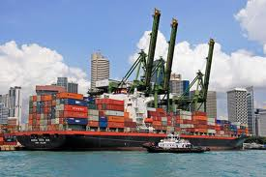
C25 - Temporary Importations

Slide 11
Goods are imported without duty payment on the basis that:
    They will be exported within 3 months or any such further period as the Commissioner of Customs may allow;
    The duty is deposited or security given against exportation
    Failure to export within the period dictated may result in the forfeiture of the deposit and where security was taken the duty must be paid.

Slide 12

C43 - Exportation for Subsequent Re-importation

Slide 13
The C43 facilitates the outward movement of goods that intend to return to the Island. Such as:
  Goods exported for repair
  Exhibitions
  Temporary use abroad
Such goods must bear distinguishing marks or features that will easily identifiable on re-importation.

Slide 14
The C87 Export Entry

Slide 15
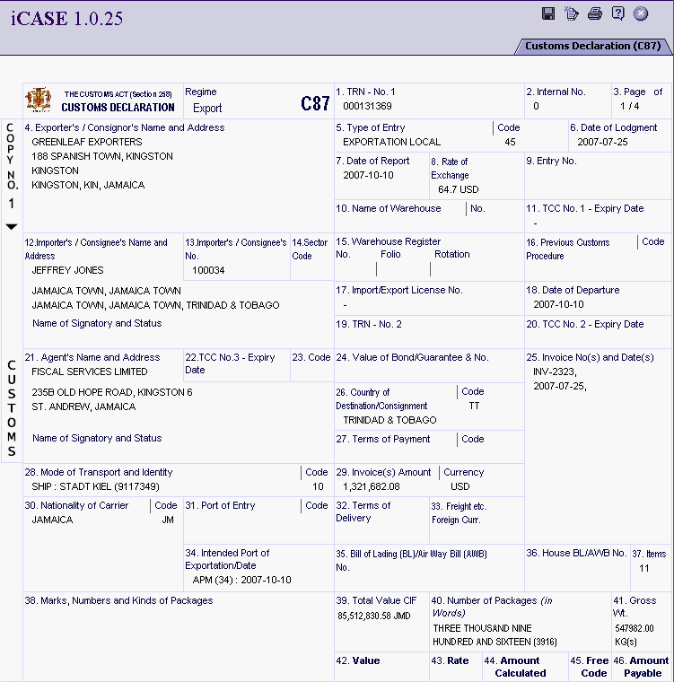

Slide 16
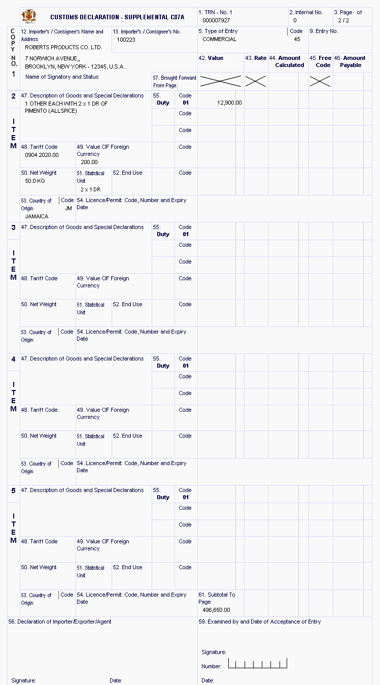

Slide 17
Supporting Documents
Commercial invoice
Dock receipt/Tally sheet
Permits/Licenses/Certificates
JAMPRO Letter (where applicable)
Certificate of Origin
EUR 1
ICO
CIB
Excise Certificate
CITES

Slide 18
Certifying Bodies
Trade Board Ltd
National Environmental Protection Agency
Ministry of Agriculture
- Plant Quarantine Division
- Veterinary Services Division
- Fisheries Division
Ministry of Industry Investment & Commerce
Coffee Industry Board
Bureau of Standard

Slide 19
E-Export - iCASE
The Export system is an Internet based system, which facilitate export entry preparation, validation and processing. This system automates the export process by allowing the brokers and exporters to lodge their entries via the Internet. It interfaces with other trade agencies in order to verify exporter’s registration details.

Slide 20



EXPORT PROCESS FL0W DIAGRAM
Invoice and Declaration Creation
Brokers must register online to use Export System
Exporters use same login from jExporter system
Registration of Exporters, Consignee and Products
Exporter/Broker create and save commercial invoices and declarations in workspace
Application for License/certificate
if required
Apply for/Attach Supporting Document
iCASE
Trade Board Limited
Approves application and notification sent to iCASE
Based on the product being exported, the system will allow for the application permits.
No supporting certification /license is required and/or already in possession
Payment Declaration generated
Print Declaration for endorsement
EPayment
CNCRS Cashier
Jamaica Customs
Customs Officer can now process the Export Entry
Enter locator #, collect fees and endorse declaration
Fail – Resubmit Entry
Pass
Hold

Slide 21
Exporter Registration System (jExporter)
J-Exporter
  J-Exporter is an Internet based system, which facilitates exporter registration and processing.
  It integrates with other agencies that need to validate exporters before allowing further processing.
Features and Functions
  Registration of consignee and products online.
  Validation of Taxpayer Registration Number
  Authorization letter requests
  Electronic Payment of Registration/Re-registration fees
  Real time transfer of information to trade agencies.

Slide 22

Integration with Other Trade Agencies
Ministry Of Agriculture
Ministry Of National Security
Pesticide Control Authority
Food Storage , Prevention & Infestation
Environmental Health
Ministry of Health
Bureau of Standards

Slide 23
Benefits To Users
24 * 7 access to Government services.
More alternatives for payment of taxes, licenses and other
government fees.
Greater business efficiencies and reduced bureaucracy for
compliant exporters.
Increased transparency in government operations.
Reduction in processing time.
Timely, accurate & convenient customer service.
Ensures Security of sensitive business information.
Expedites overall process of exporting goods.

Slide 24
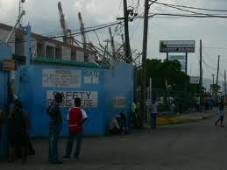
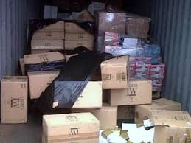

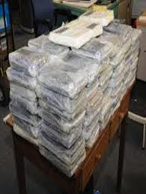

Border Control

Slide 25


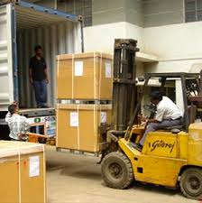

Border Control
Begins with the Exporter

Slide 26
Border Control
It is also the mandate of every Customs Official:
  The Export Officer who vets the Entry and Permits and examines the cargo
  The Cargo Imaging Officer who scans the cargo prior to export
  The Contraband Enforcement Team (CET) who will conduct further examinations as well as oversee the loading of cargo prior to arrival at the Port.

Slide 27
Thank You

Slide 28

Contact Information
CET – 923-7641/757-3912
BERTH XI – 923-7018 ext. 360, 480 or 319
KINGSTON WHARVES – 923-0415
NORMAN MANLEY INTERNATIONAL AIRPORT (AIR CARGO) – 924-8084
CUSTOMS HOUSE (KINGSTON) – 922-5140-9
MONTEGO FREEPORT – 979-8126
SANGSTER INTERNATIONAL AIRPORT (AIR CARGO)– 952-2537
MONTEGO BAY REVENUE CENTER (CUSTOMS) – 952-0000
To notify of short loading in Kingston: exportmarinekgn@jacustoms.gov.jm
www.jacustoms.gov.jm

